Slide 1
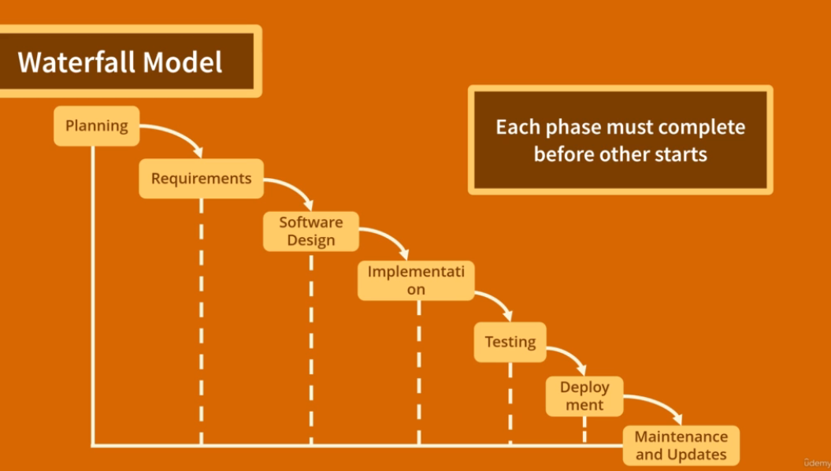

Slide 2
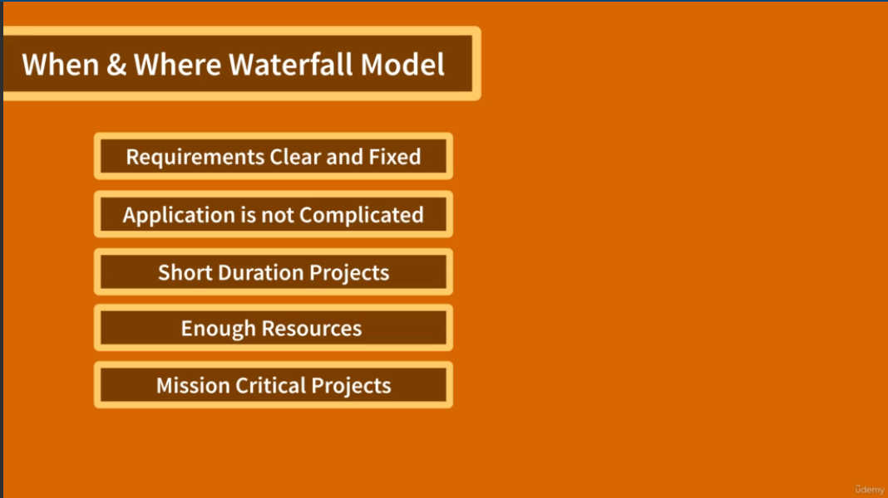

Slide 3
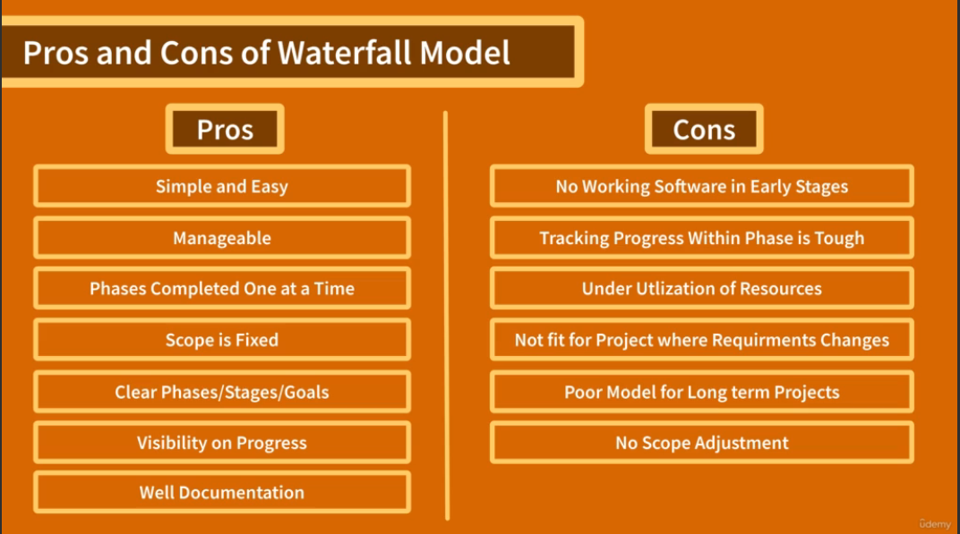

Slide 4
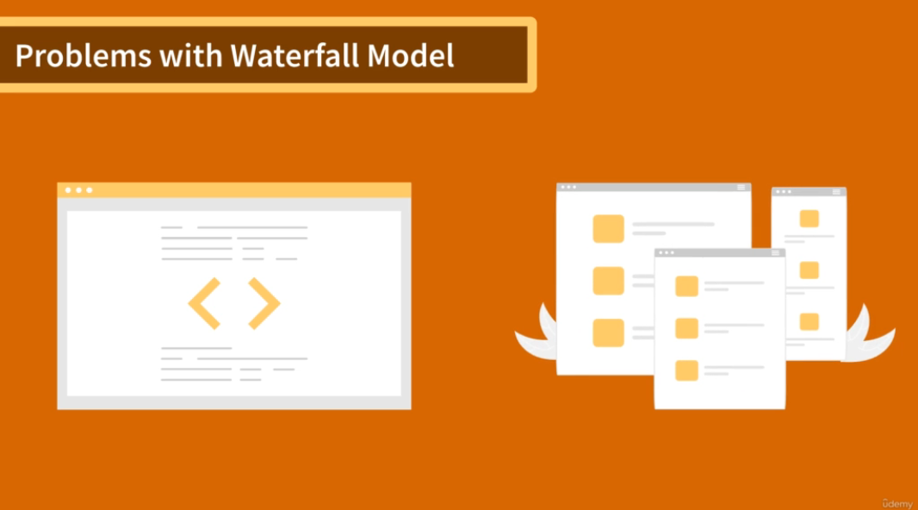

Slide 5
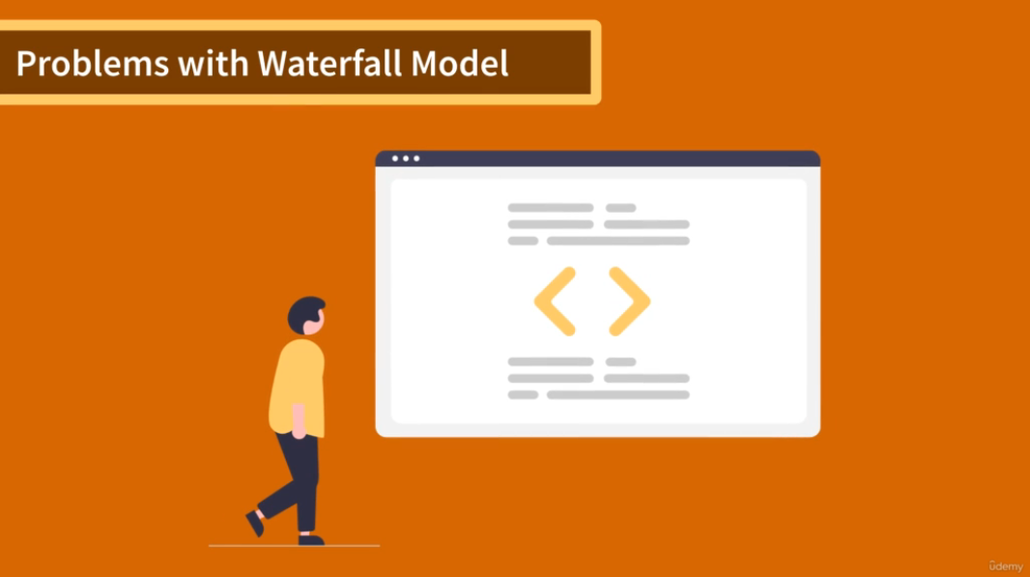

Slide 6
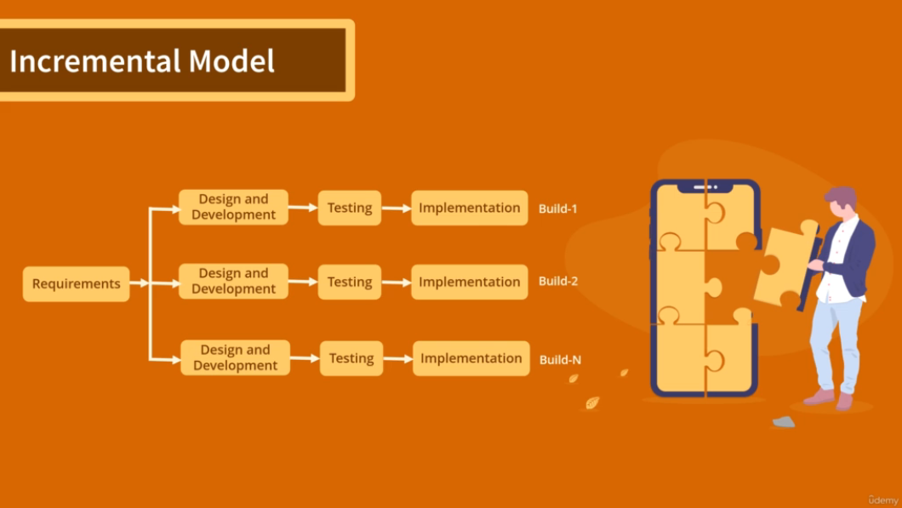

Slide 7
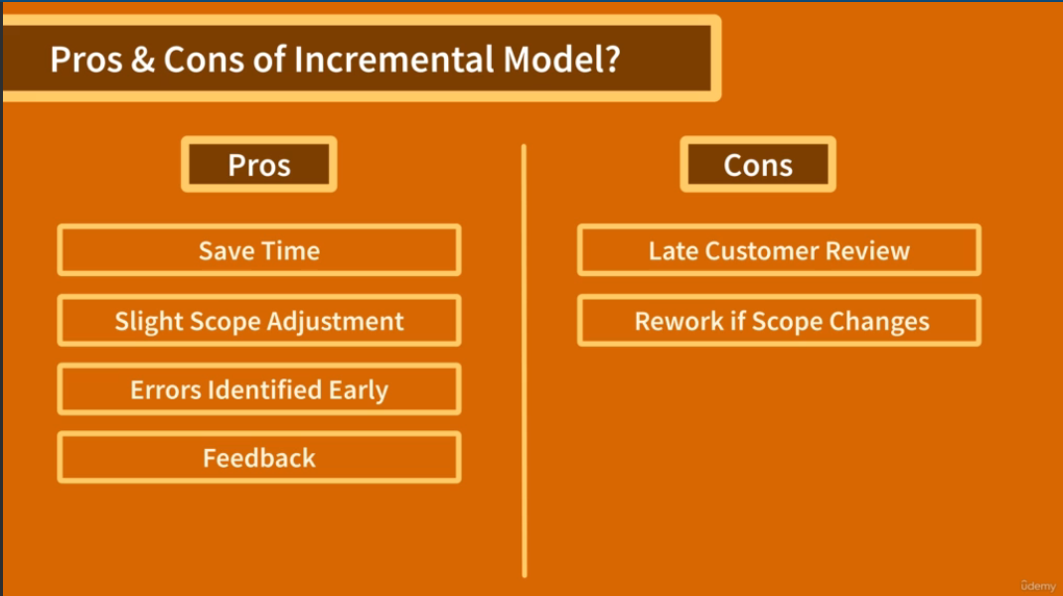

Slide 8
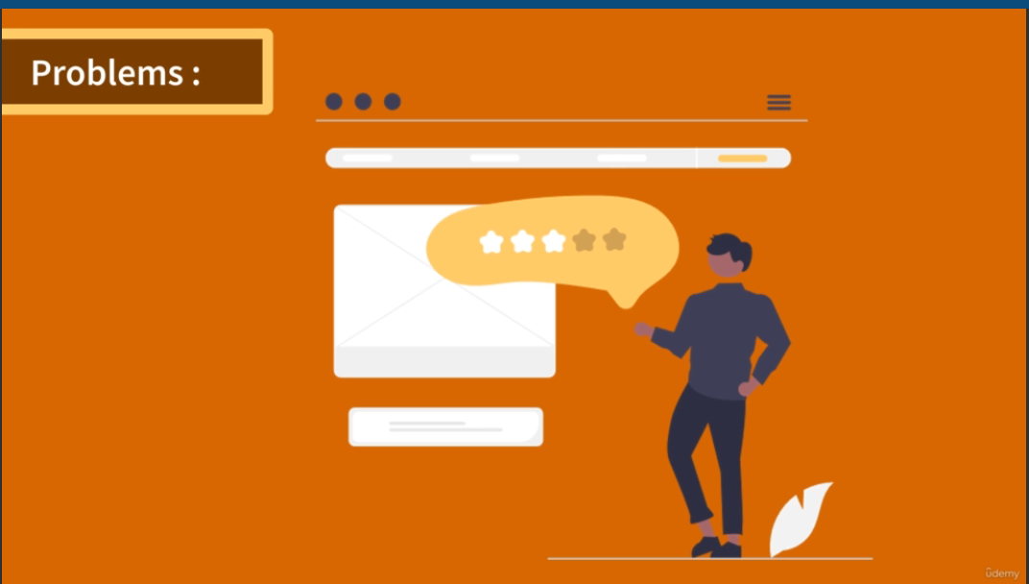

Slide 9
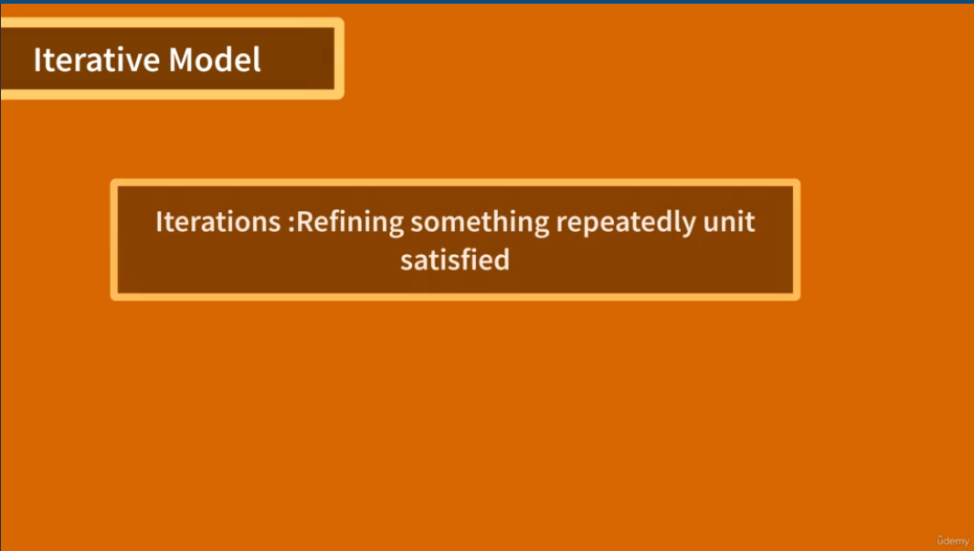

Slide 10
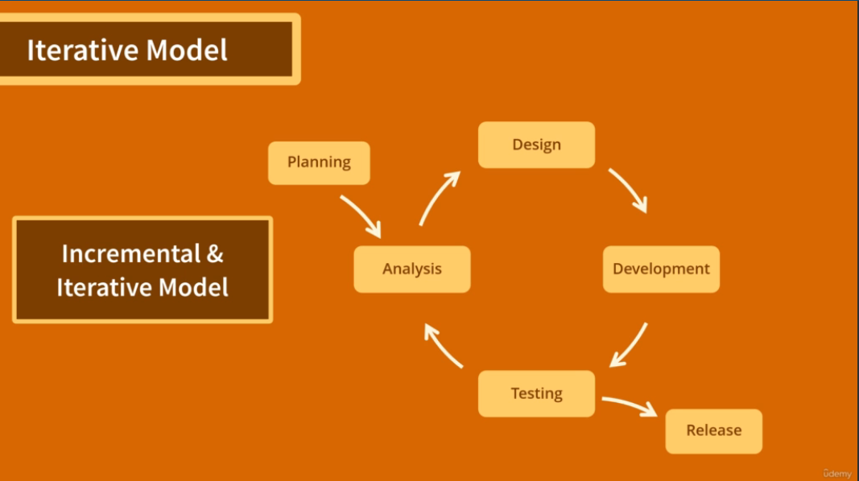

Slide 11
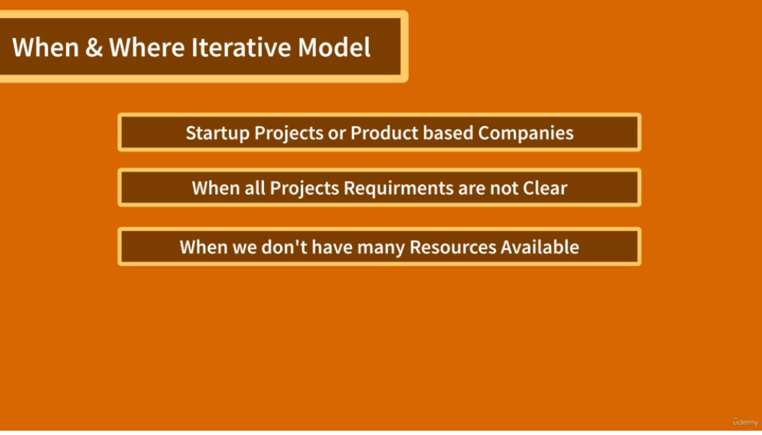

Slide 12
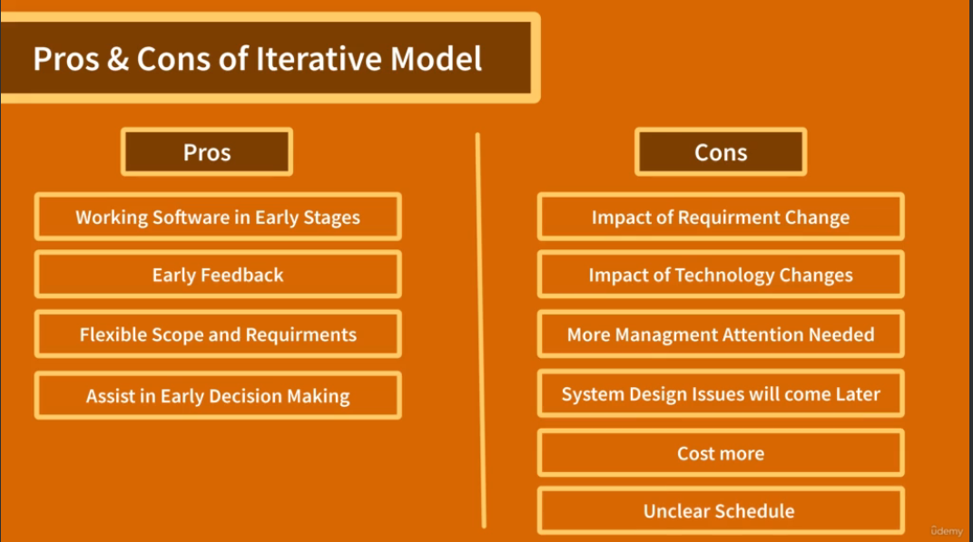

Slide 13
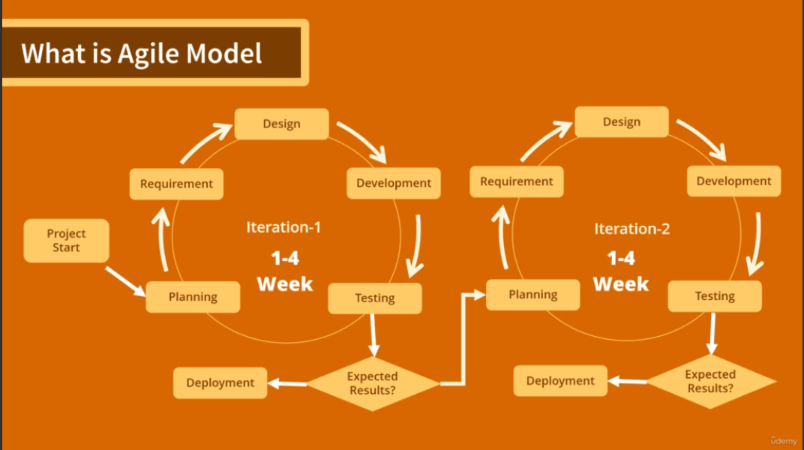

Slide 14
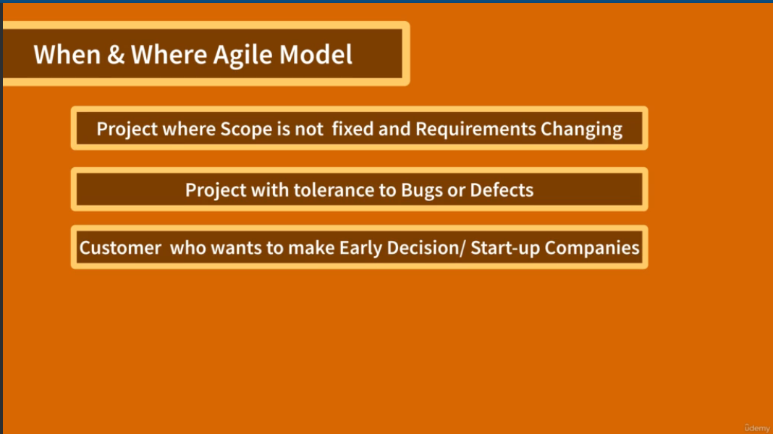

Slide 15
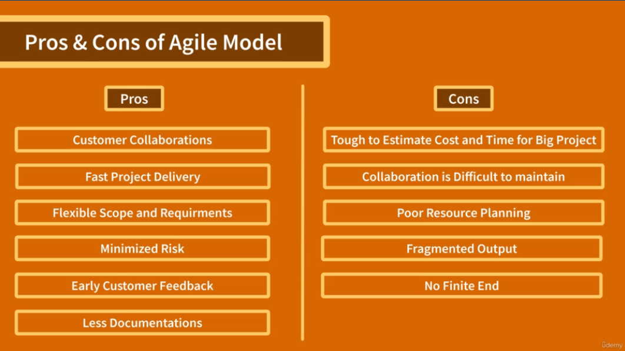

Slide 16
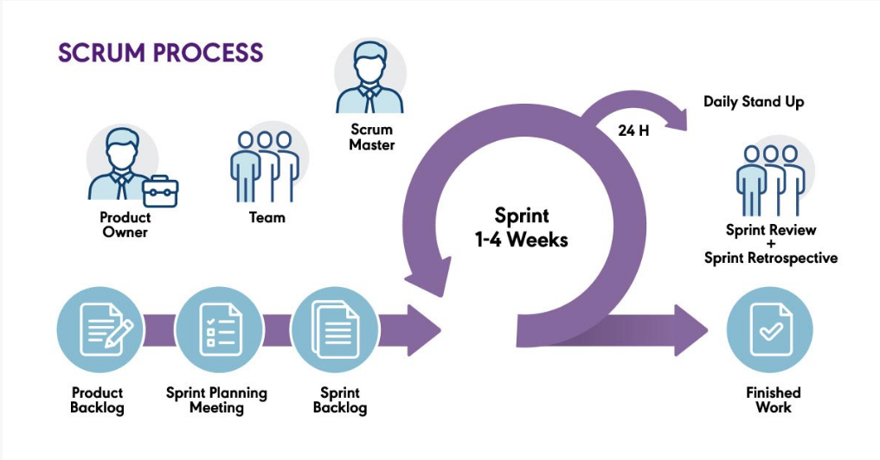

Slide 17
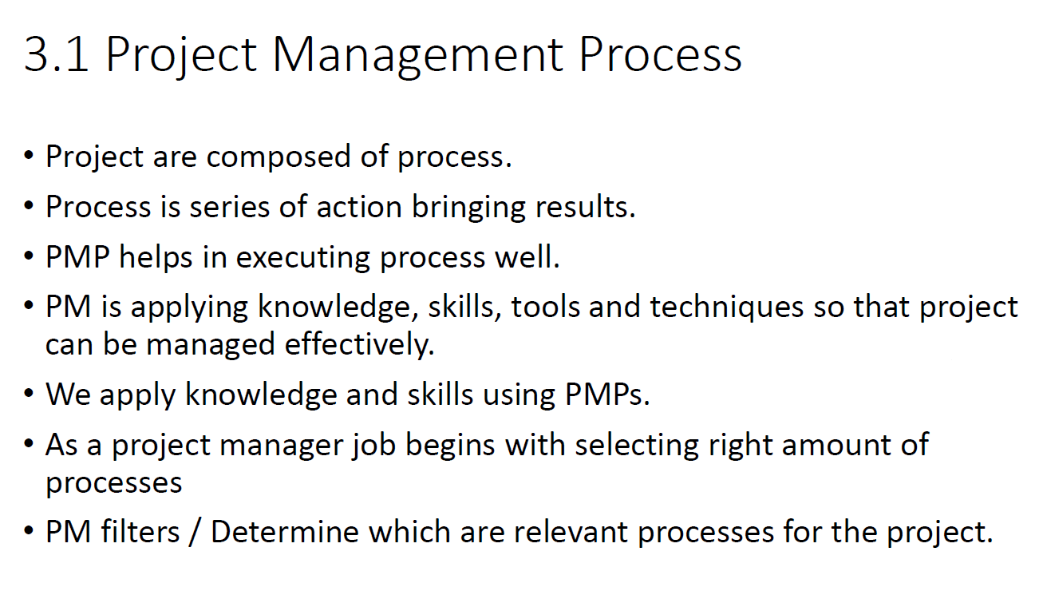

Slide 18
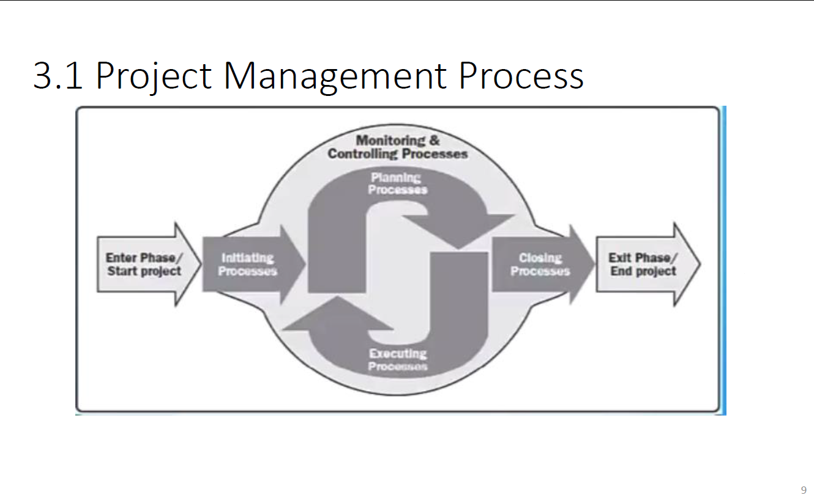

Slide 19
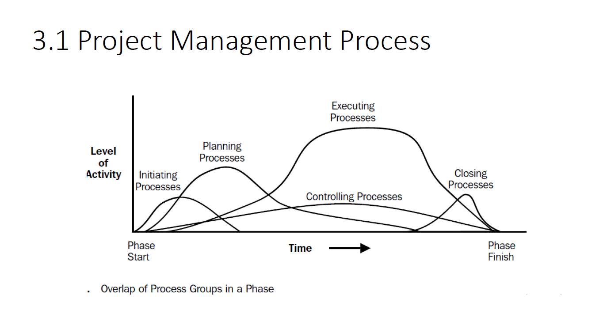

Slide 20
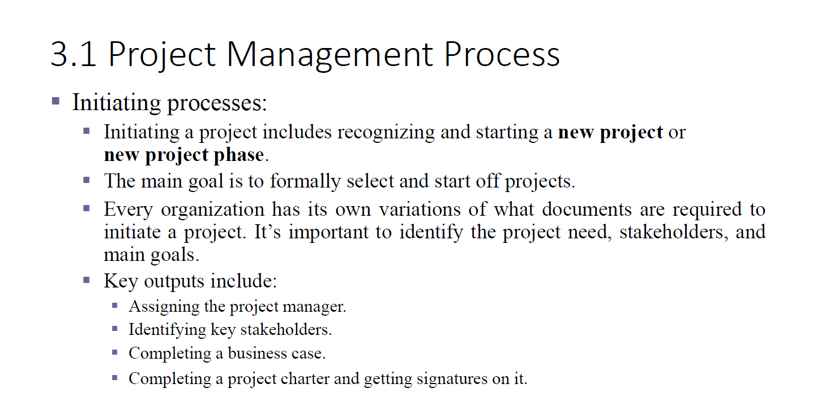


Slide 21
Project Charter
Developing a Project Charter is the first step in initiating a project.
The Project Charter is a formal document that provides authority to the project manager and officially starts the project.
It outlines the project's objectives, scope, stakeholders, and overall vision.
Remember that the Project Charter is a living document and may be updated as the project progresses and more information becomes available.
Below are the key components to include when developing a Project Charter:

Slide 22
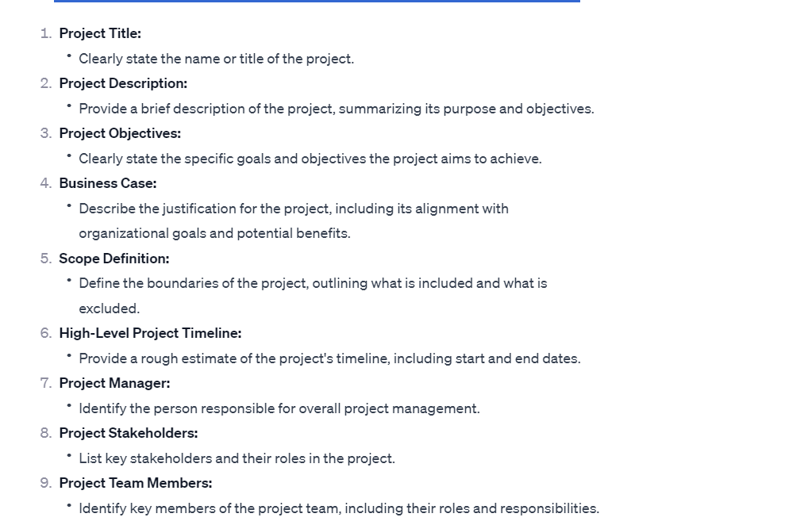

Slide 23
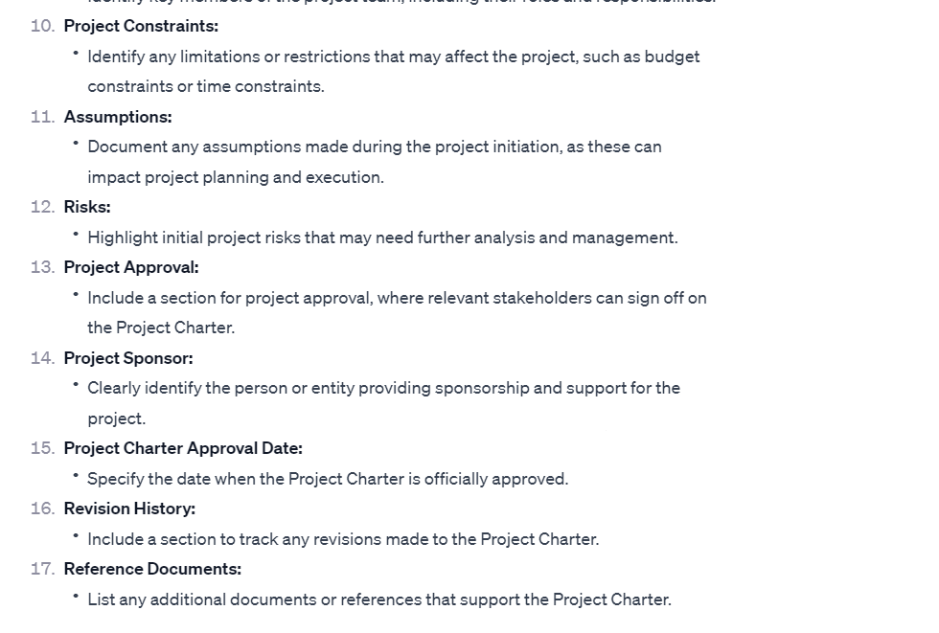

Slide 24
Stakeholders are individuals, groups, or organizations that may affect, be affected by, or perceive themselves to be affected by a decision, activity, or outcome of the project.
Project Sponsor
Customers/Clients
Project Team
Project Management Team
Subject Matter Experts (SMEs)
Regulatory Bodies
Competitors
Suppliers and Vendors
Financial Institutions
Unions
Media

Slide 25
Project Planning
The Project Planning phase is a critical component of the project management life cycle, and it involves defining, refining, and documenting the project scope, objectives, and strategies for achieving those objectives.
Develop Project Management Plan
Create a comprehensive Project Management Plan that defines how the project will be executed, monitored, and controlled
Plan Scope Management
Define how project scope will be defined, validated, and controlled throughout the project. This includes creating a scope statement, a work breakdown structure (WBS)
Collect Requirements
Gather and document stakeholder needs and requirements through various methods such as interviews, surveys, and focus groups. These requirements will help shape the project scope.
Define Scope
Develop a detailed project scope statement based on the collected requirements. Clearly outline what is included and excluded from the project.
Create Work Breakdown Structure (WBS)
Decompose the project into smaller, more manageable components using a hierarchical WBS. This helps in organizing and understanding the scope of work.

Slide 26
Project Planning
Plan Schedule Management
Define how the project schedule will be created, executed, and controlled. This includes identifying milestones, activities, dependencies, and resource requirements.
Define Activities
Identify and document the specific activities that need to be performed to produce the project deliverables. This involves breaking down the work packages from the WBS into detailed tasks
Sequence Activities
Establish the order and dependencies among project activities. This helps create a logical flow of work and determines the project schedule.
Estimate Activity Durations
Estimate the time required to complete each project activity. This involves considering factors such as resource availability, skill levels, and historical data.
Develop Schedule
Create the project schedule by analyzing activity sequences, durations, and resource requirements. The output is a project schedule that includes start and finish dates for each activity.
Plan Cost Management
Define how the project costs will be estimated, budgeted, managed, and controlled. This involves creating a cost management plan.

Slide 27
Project Planning
Plan Quality Management
Define how quality will be planned, assured, and controlled throughout the project. Develop a quality management plan that outlines the standards and processes to be used.
Plan Resource Management
Define how project resources, including human resources, equipment, and materials, will be acquired, developed, and managed
Estimate Activity Resources
Estimate the type and quantity of resources required for each project activity. This includes personnel, equipment, and materials.
Plan Communications Management
Define how project communications will be planned, distributed, and managed. Develop a communications management plan that outlines the communication requirements and expectations
Plan Risk Management
Establish how risks will be identified, assessed, and managed throughout the project. Develop a risk management plan that includes risk identification, analysis, response planning, and monitoring.
Plan Procurement Management
Define how project procurement will be managed, from planning through contract closure. Develop a procurement management plan that outlines the procurement requirements and processes.

Slide 28
Key Outputs from Planning Phase:
Project Management Plan: Comprehensive document outlining how the project will be executed, monitored, and controlled.
Scope Statement: Clearly defining the project's scope, objectives, constraints, and acceptance criteria.
Work Breakdown Structure (WBS): Hierarchical decomposition of the total scope of work to be carried out by the project team.
Project Schedule: Timeline of project activities, including start and finish dates for each task.
Cost Estimate and Budget: Estimated costs for project activities and an authorized budget.
Quality Management Plan: Outlining how quality will be planned, assured, and controlled.
Resource Management Plan: Describing how resources, including human resources, equipment, and materials, will be acquired, developed, and managed.
Communications Management Plan: Defining how communication will be planned, distributed, and managed.
Risk Management Plan: Outlining how risks will be identified, assessed, and managed throughout the project.
Procurement Management Plan: Describing how project procurement will be managed, including contracts and vendor relationships.
Stakeholder Engagement Plan: Defining strategies for effectively engaging stakeholders throughout the project.

Slide 29
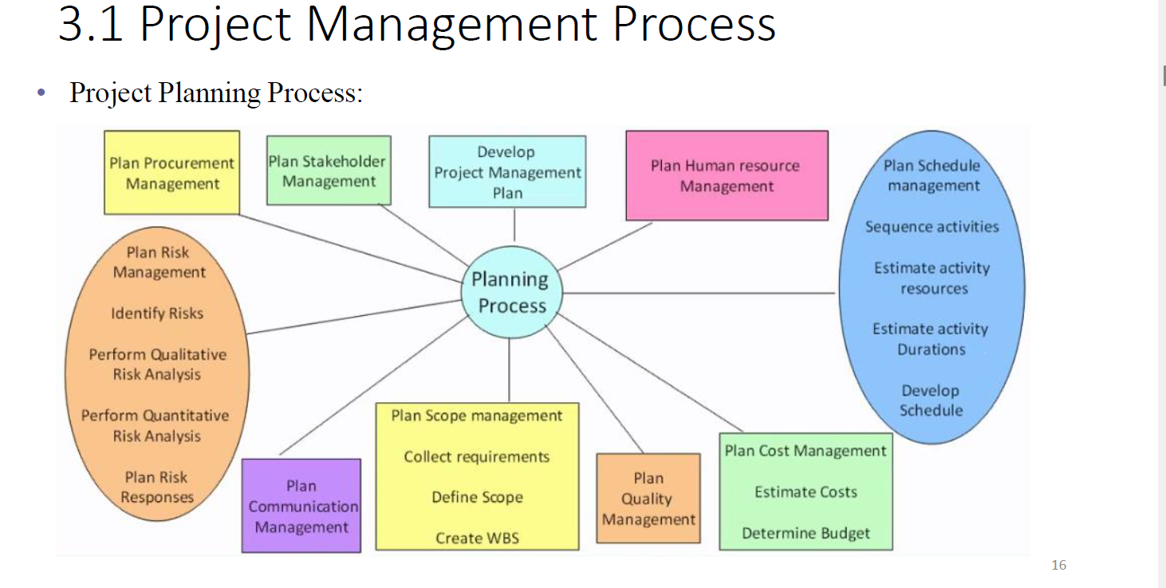

Slide 30
Work Breakdown Structure (WBS)
The Work Breakdown Structure (WBS) is a fundamental tool in project management that breaks down a project into smaller, more manageable components.
Define the Project Scope:
Clearly understand and define the overall scope of the project.
Identify Major Deliverables:
Break down the project into major deliverables or work packages. These are the high-level components that represent significant achievements in the project.
Decompose Major Deliverables
Break down each major deliverable into smaller, more manageable sub-deliverables. Continue this process until you reach a level where work can be easily understood and assigned to a specific team or individual.

Slide 31
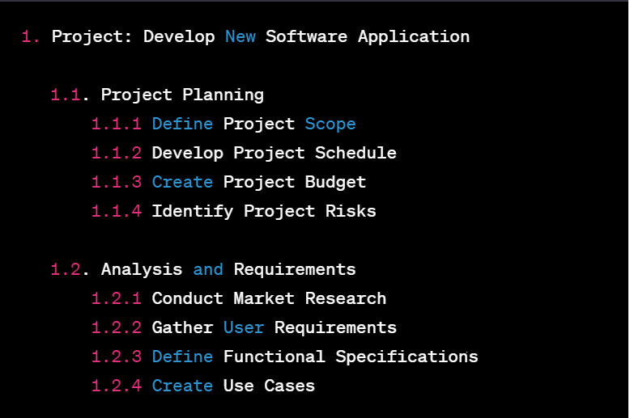

Slide 32
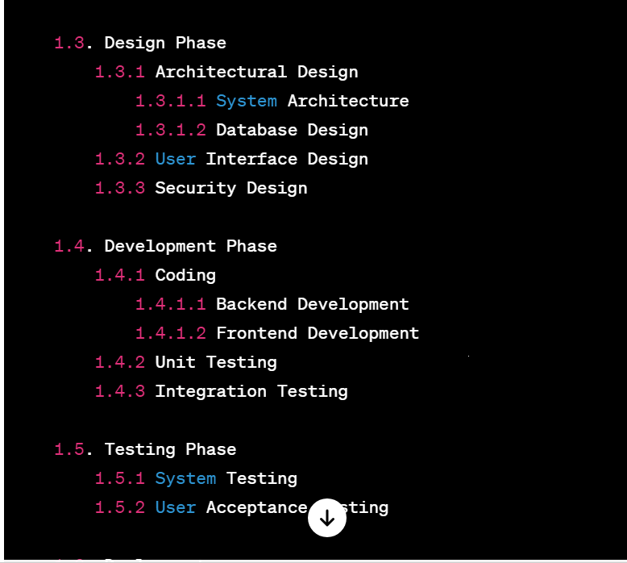

Slide 33
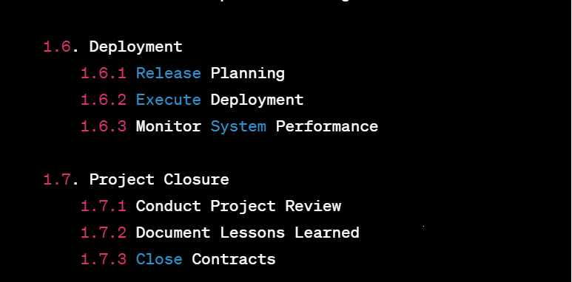

Slide 34
Project Execution
The Project Execution phase is a critical stage in the project management life cycle where the project plan is put into motion to accomplish the project's objectives
Key Activities in the Project Execution Phase
Direct and Manage Project Work
This includes coordinating people and resources, managing project performance, implementing approved changes, and ensuring the project stays on course.
Perform Quality Assurance
Audit the project to ensure that the processes are being followed and that project deliverables meet the defined quality standards.
Acquire Project Resources
Obtain the necessary personnel, equipment, materials, and supplies to support project activities. This includes hiring and training team members, acquiring physical resources, and ensuring availability as needed.
Develop Project Team
Enhance project team performance through activities such as team-building, training, and recognition. This involves improving communication, resolving conflicts, and fostering a positive team culture.

Slide 35
Project Execution
The Project Execution phase is a critical stage in the project management life cycle where the project plan is put into motion to accomplish the project's objectives
Key Activities in the Project Execution Phase
Manage Project Team
Track team member performance, provide feedback, resolve issues, and manage changes to optimize project performance. This involves keeping the team motivated and focused on project goals.
Manage Communications
Ensure timely and appropriate collection, generation, distribution, storage, retrieval, and disposition of project information. This involves effective communication with stakeholders to keep them informed of project progress.
Implement Risk Responses
Execute the risk response plans developed during the planning phase. This involves addressing identified risks and implementing strategies to mitigate, transfer, accept, or avoid them

Slide 36
Project Execution
The Project Execution phase is a critical stage in the project management life cycle where the project plan is put into motion to accomplish the project's objectives
Key Activities in the Project Execution Phase
Conduct Procurements
Obtain goods and services from external vendors or contractors as outlined in the procurement management plan. This includes managing procurement relationships and ensuring that deliverables meet the specified requirements.
Manage Stakeholder Engagement
Engage stakeholders in a way that aligns with their needs and expectations. This involves communicating with stakeholders, addressing concerns, and managing stakeholder involvement throughout the project.

Slide 37
Key Considerations:
Change Management:
Implement a robust change management process to address changes to project scope, schedule, and resources. Ensure that changes are documented, approved, and communicated to relevant stakeholders.
Quality Control:
Perform quality control activities to ensure that project deliverables meet the specified quality standards. This involves inspecting, testing, and validating project outputs.
Issue Resolution:
Address and resolve issues that arise during project execution. This involves identifying and resolving problems that may impact project progress.
Performance Reporting:
Provide regular and accurate performance reports to stakeholders. This involves tracking key performance indicators and communicating project status, progress, and potential issues.
Resource Allocation:
Optimize the allocation of resources to meet project objectives. This involves managing resource constraints, balancing workloads, and adjusting resource assignments as needed.

Slide 38
Key Considerations:
6. Communication Management:
Ensure effective communication throughout the project. This involves using various communication channels and methods to convey information to the project team and stakeholders.
7. Monitoring and Controlling:
Continuously monitor and control project activities to ensure they align with the project plan. This involves comparing actual performance against the project management plan and taking corrective action when necessary.
8. Documentation:
Maintain accurate and up-to-date project documentation. This involves recording decisions, changes, and other project-related information to provide a historical record of the project.
9. Procurement Management:
Oversee and manage procurement activities, contracts, and relationships with vendors. This involves ensuring that procurements are executed according to the procurement management plan.
10. Stakeholder Engagement:
Keep stakeholders engaged and informed about project progress. This involves addressing stakeholder concerns, managing expectations, and adapting communication strategies as needed.

Slide 39
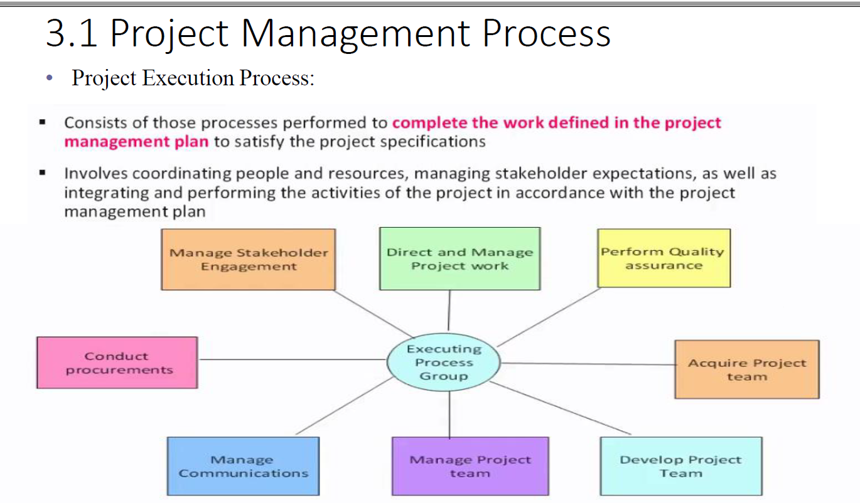

Slide 40
Project monitoring and controling
The Project Monitoring and Controlling phase is a crucial stage in the project management life cycle. It involves tracking, reviewing, and regulating the progress and performance of the project to ensure that project objectives are met.
Monitor and Control Project Work
Track, review, and regulate project performance and progress. This involves comparing actual project performance against the project management plan, identifying variances, and taking corrective actions as needed.
Verify Scope:
Formalize acceptance of the project deliverables. This involves ensuring that the project has delivered what was agreed upon in the scope statement.
Control Scope
Manage changes to the project scope. This involves preventing scope creep and addressing any unauthorized changes to the project scope.
Control Schedule
Monitor and control project schedule performance. This involves comparing planned schedule activities and milestones with the actual progress and taking corrective actions as needed.

Slide 41
Project monitoring and controlling
Control Costs
Monitor and control project costs. This involves tracking project expenditures against the approved budget and making adjustments as necessary.
Perform Quality Control
Monitor and verify that project deliverables meet the specified quality standards. This involves inspecting, testing, and validating project outputs.
Report Performance
Communicate project status and performance to stakeholders. This involves preparing regular performance reports, which may include key performance indicators, progress updates, and forecasts.
Monitor and Control Risks
Continuously assess and respond to project risks. This involves tracking identified risks, implementing risk response plans, and identifying new risks as the project progresses.
Administer Procurements
Manage procurement relationships and contracts. This involves ensuring that vendors are meeting their contractual obligations and addressing any issues that may arise.
Monitor Stakeholder Engagement:
Track stakeholder engagement and adjust strategies as needed. This involves assessing the effectiveness of stakeholder communication and engagement activities.

Slide 42
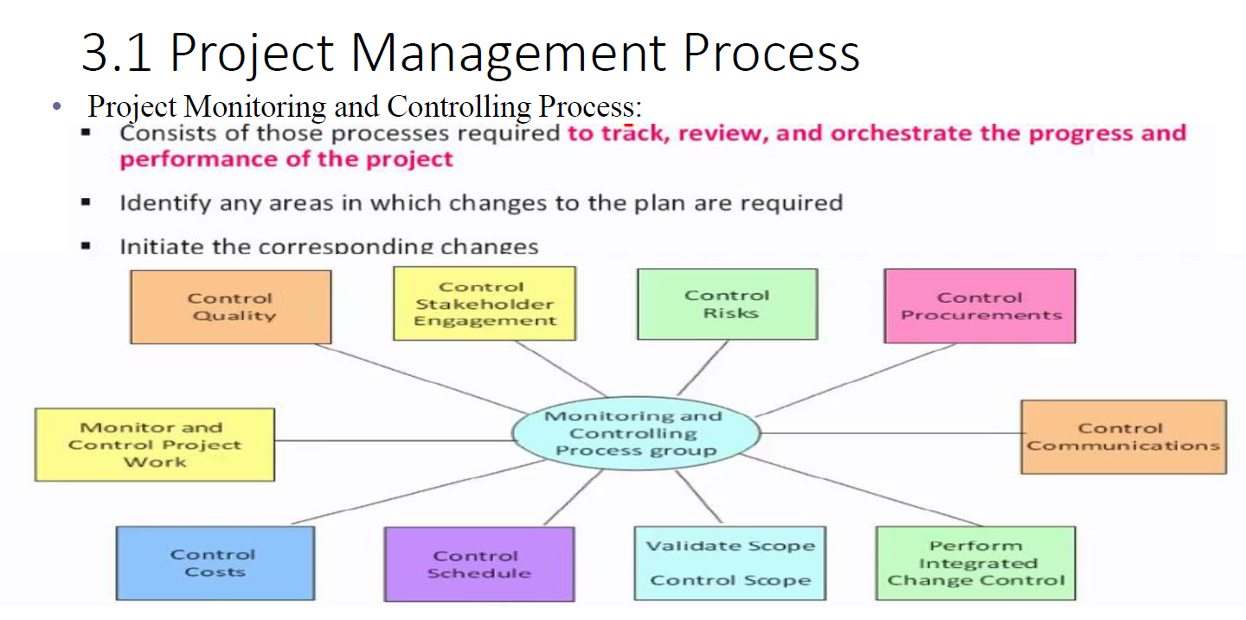

Slide 43
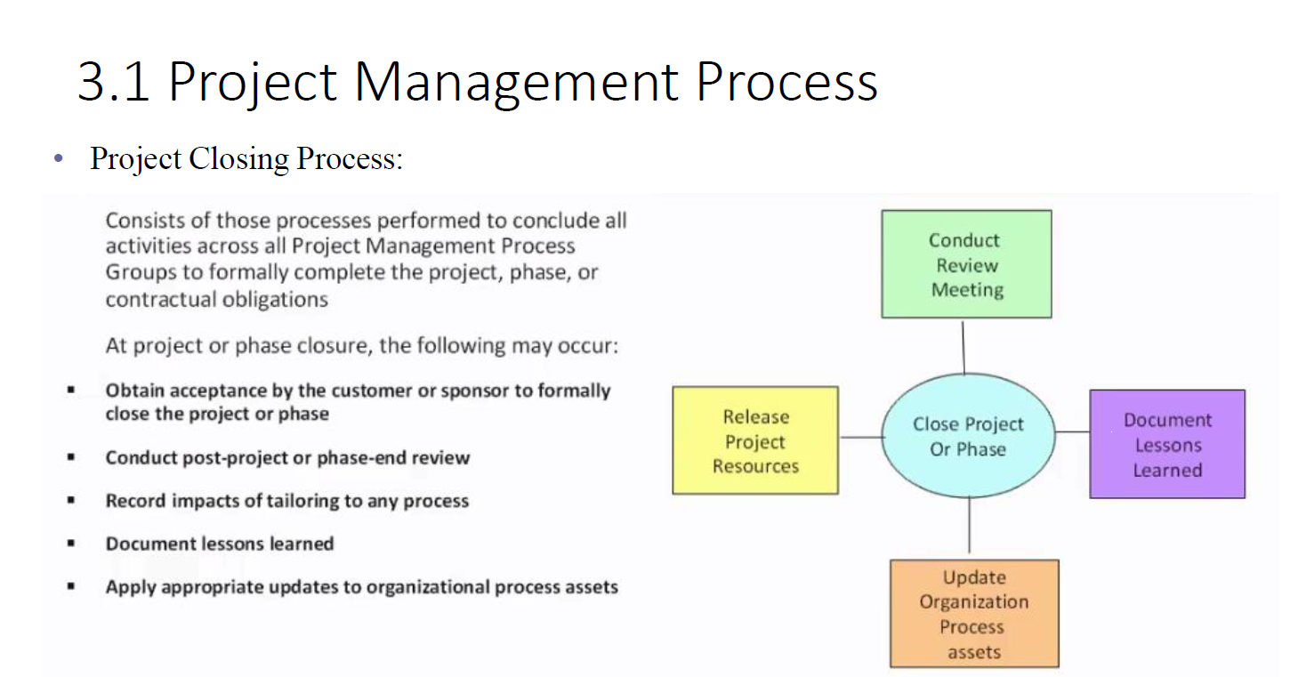

Slide 44
Project Closing
The Project Closing phase is the final stage in the project management life cycle, and it involves completing all project activities, obtaining customer or stakeholder acceptance, and formally closing out the project.
Close Project or Phase
Finalize all project activities, deliverables, and documentation. Obtain formal acceptance from the customer or stakeholders that the project objectives have been met.
Close Procurements
Complete and settle any remaining procurements. This involves ensuring that all contractual obligations have been met, final payments are made, and contracts are officially closed.
Perform Final Performance Reporting
Summarize and communicate the final project performance. This involves comparing planned performance with actual performance and documenting key project metrics and achievements.
Archive Project Documents
Organize and store all project documentation in a central repository. This involves archiving project plans, reports, contracts, and other relevant documents for future reference.

Slide 45
Project Closing
Obtain Formal Acceptance:
Obtain formal acceptance of the project deliverables from the customer or stakeholders. This involves ensuring that the project has met the agreed-upon criteria and that all parties are satisfied with the outcomes.
Release Project Resources
Release project team members and resources. This involves formally notifying team members of their completion of project assignments and releasing any project-related resources, such as equipment or facilities.
Close Out Contracts
Complete and close out all contractual agreements related to the project. This involves settling any outstanding contractual issues, making final payments, and obtaining formal closure from vendors or suppliers.
Conduct Post-Implementation Review:
Evaluate the project's overall success and performance. This involves conducting a post-implementation review to identify lessons learned, best practices, and areas for improvement.

Slide 46
Key Considerations:
Customer Sign-Off:
Obtain formal sign-off and acceptance from the customer or stakeholders. This involves ensuring that the project outcomes meet their expectations and requirements.
Lessons Learned:
Conduct a formal lessons learned session to capture insights from the project. This involves documenting what worked well, what could be improved, and recommendations for future projects.
Project Closure Report:
Prepare a project closure report. This document summarizes the project's performance, achievements, challenges, and recommendations for future projects.
Resource Reassignment:
Reassign project team members to new projects or roles. This involves communicating future assignments and providing support for transitioning team members.
Celebration and Recognition:
Celebrate the project's success and recognize the contributions of the project team. This involves acknowledging achievements, milestones, and the hard work of team members.

Slide 47
Key Considerations:
Customer Sign-Off:
Obtain formal sign-off and acceptance from the customer or stakeholders. This involves ensuring that the project outcomes meet their expectations and requirements.
Lessons Learned:
Conduct a formal lessons learned session to capture insights from the project. This involves documenting what worked well, what could be improved, and recommendations for future projects.
Project Closure Report:
Prepare a project closure report. This document summarizes the project's performance, achievements, challenges, and recommendations for future projects.
Resource Reassignment:
Reassign project team members to new projects or roles. This involves communicating future assignments and providing support for transitioning team members.
Celebration and Recognition:
Celebrate the project's success and recognize the contributions of the project team. This involves acknowledging achievements, milestones, and the hard work of team members.
Feedback and Evaluation:
Collect feedback from project team members, stakeholders, and other relevant parties. This involves evaluating the project's processes, outcomes, and the effectiveness of project management practices.

Slide 48
